Slide 1
Iceberg Detection and Tracking using Machine Learning
Sania Bandekar and Victoria Le

Slide 2
Introduction
Many researchers have utilized machine learning in order to detect icebergs and analyze them as they have a significant influence on oceanic properties.
Recent advancements in deep learning, convolutional neural networks (CNNs) in particular, have been very useful for iceberg detection from satellite images.
Notes:
Victoria
(After first bullet point) From the University of Leeds, Dr. Anna Brackmann-Folgmann states that “"It is crucial to locate icebergs and monitor their extent, to quantify how much meltwater they release into the ocean” Ben Evans and Scott Hosking, who are both a part of the British Antarctic Survey (BAS) AI Lab also work with machine learning to monitor the changes in icebergs as a consequence of climate change. Their approaches allow for identifying the icebergs in places where there are a lot of sea ice and track them.

Slide 3
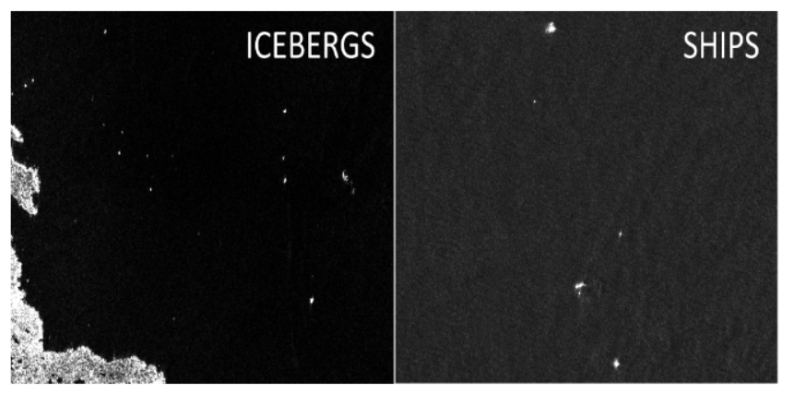
Dataset Preparation
The project uses an existing dataset from Kaggle due to the limited availability of adequately sized iceberg satellite images.
The dataset contains radar images of both icebergs and ships to help train the model on distinguishing from both iceberg and non-iceberg objects.
Data was processed with scikit-learn
Notes:
Sania- Dataset Preparation
Loading Data:
Training and test data are loaded from JSON files using the load_data function.
Each instance in the training data includes a band_1 feature, reshaped into a 75x75 pixel array, and a label indicating whether the image contains an iceberg (is_iceberg).
Normalization:
A normalization function scales the pixel values of images to a range between 0 and 1, improving model training effectiveness.
Train-Validation Split:

Slide 4
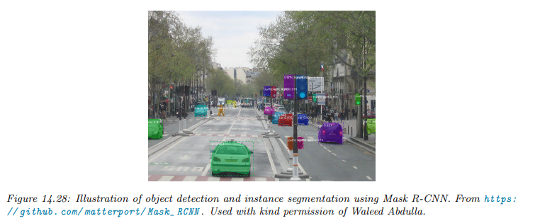
Convolutional Neural Network (CNN)
After reviewing the types of neural networks, we decided to use CNN as it is the most suitable architecture for image processing and classification
CNNs are designed to maintain the local spatial structure of images and similar data
Learns through progressive levels of abstraction which allows them to recognize patterns in early layers and more complex patterns in deeper layers
Notes:
Sania- Convolutional Neural Network (CNN) Architecture
Hyperparameter Definition:
Several model hyperparameters are defined, including batch size, number of epochs, kernel size, pooling size, and depths for convolutional and dense layers.
Model Architecture: A sequential
Convolutional Layers: Three convolutional layers with increasing depth (32, 64, and 128 filters)
apply convolution operations with ReLU activations and batch normalization.
Pooling Layers: Max pooling layers follow each convolutional layer, reducing spatial dimensions.
Flattening and Dense Layers: The feature maps are flattened, followed by a dense layer with ReLU activation and dropout for regularization, leading to an output layer with a sigmoid activation for binary classification.
Compilation:
The model is compiled with the Adam optimizer and binary cross-entropy loss, monitoring accuracy as a metric.
A learning rate reduction callback is added to adjust the learning rate when the validation loss plateaus.
Model Training and Evaluation
Training:
Model Saving:
Predictions:
Visualization:

Slide 5
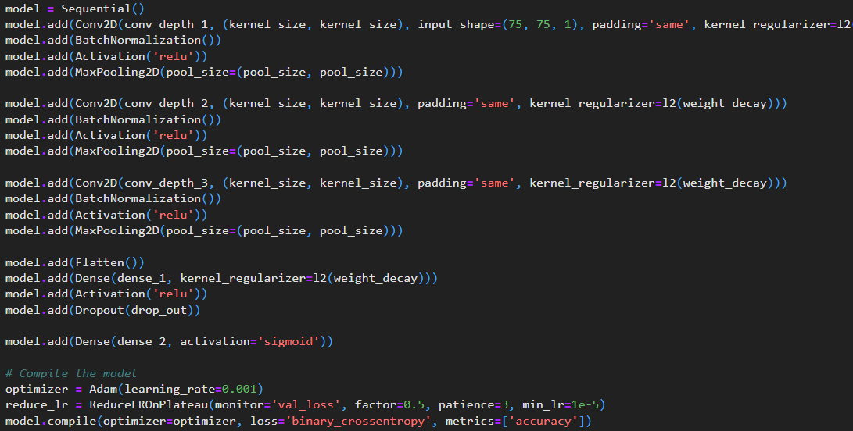
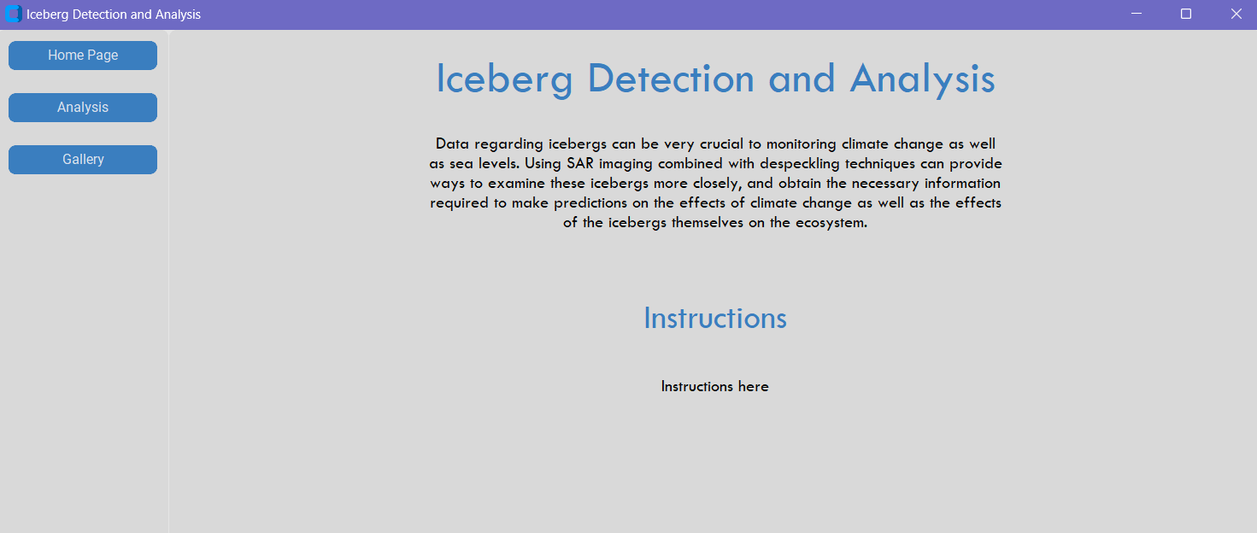
Progress
Data Preparation
Picked a neural network to use: CNN
Training and Testing
Development of User Interface
Notes:
Victoria To summarize what we have so far, as seen in the previous slides, we have been able to prepare the data and chose to work with a convolutional neural network. There has also been progress with training and testing. We have also developed a basic user interface for ease of use.

Slide 6
Next Tasks to complete
Determining best model accuracy and loss by average
Integrating Backend with Frontend UI
If possible: Iceberg Size Calculation with U-Net
We plan to look into adding an additional feature to our application where users can upload a higher quality image of an iceberg
Notes:
Victoria

Slide 7
References
David Hogg Anne Braakmann-Folgmann, Andrew Shepherd and Ella Redmond. Mapping the extent of giant antarctic icebergs with deep learning, 2023.
Hankyu Jang. Statoil-c-core-iceberg-classifier-challenge, 2017.
Kaggle. Statoil/c-core iceberg classifier challenge, 2017.
University of Leeds. Ai can map the outline and area of giant icebergs, November 9 2023.

Slide 8
Thank you!

